Slide 1
Stenography Application
By Kaiden Love & Logan Bennett

Slide 2
Goals
Create a GUI Application that supports image encryption and decryption
Make it user friendly
Make it low resource

Slide 3
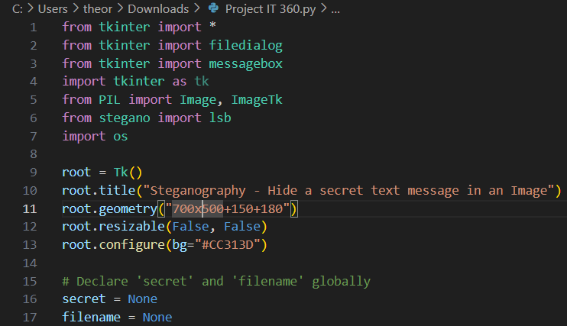
Functionality

Slide 4
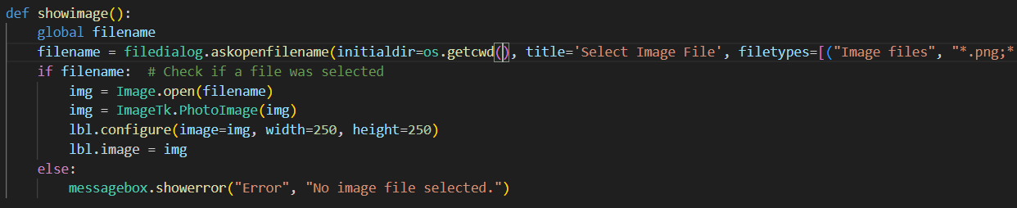
Functionality

Slide 5
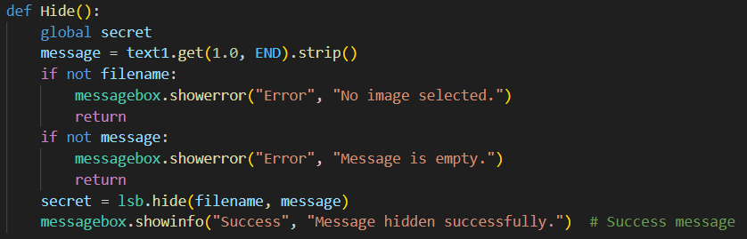
Functionality

Slide 6
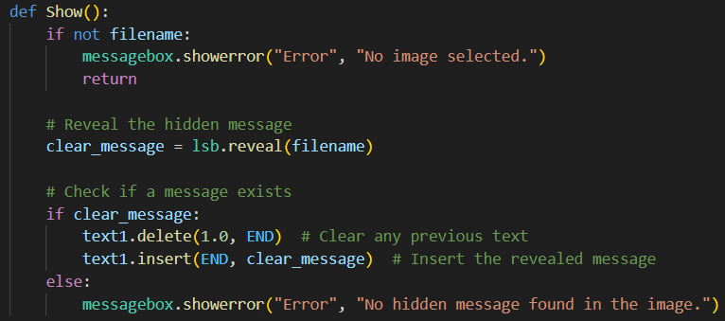
Functionality

Slide 7
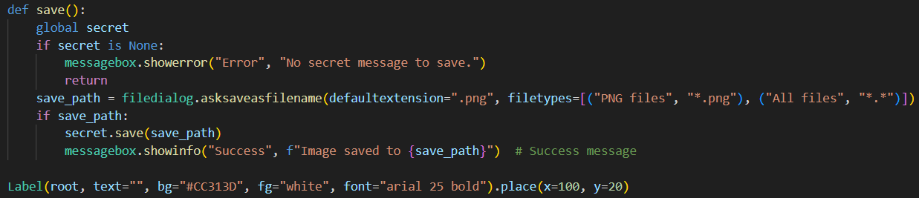
Functionality

Slide 8
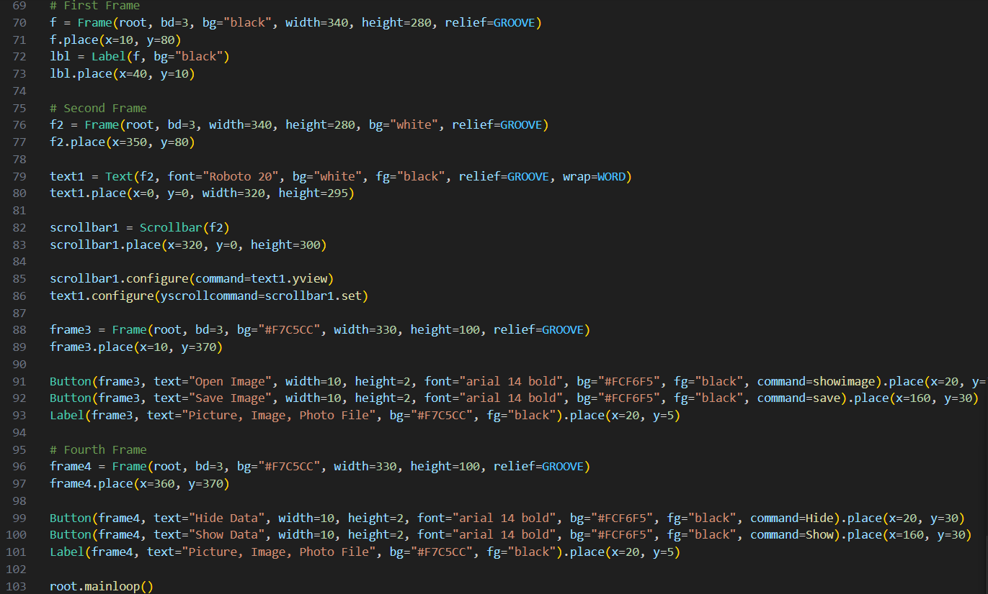
Functionality

Slide 9
Demonstration

Slide 10
Takeaways
LSB Cryptography
Image Format
OS Pathway/Directory
Python Compiler

